Slide 1
Lumos The Smart Light Switch
Ari Biswas, Theo Dahlen, Jordan Friendshuh, Josh Graf

Slide 2
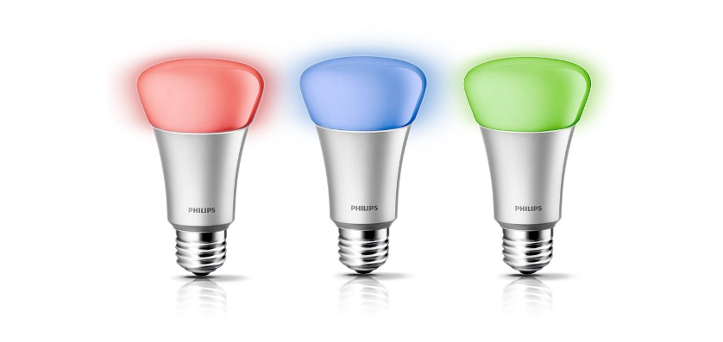
Philips Hue
110V AC
WiFi

Slide 3
Philips Hue
Smart Light App and light switch do not work together
110V AC
WiFi
Hue Bulb
Notes:
If you turn off the light switch, you can no longer control the hue from your phone.
You shouldn’t have to think about how to go about turning on your lights. You should just do it.

Slide 4
Philips Hue + Smart Switch
110V AC
Hue Bulb
WiFi
WiFi
Smart Switch

Slide 5
Smart Switch + Conventional Bulbs
110V AC
Standard or IR Bulb
IR
WiFi
Smart Switch

Slide 6
Contents
Why Lumos?
Hardware features
Capabilities
Power Board
Top Board
Software features
Tiva
Peripherals
Android App

Slide 7
Hardware Features - Capabilities
Bulb Control
WiFi
IR LED
Relay
User Input
Knob
Push Button
Rotary Encoder
RGB LEDs for Feedback
Microphone
Enviroment Sensing
Ambient Light Sensor
Motion Sensor

Slide 8
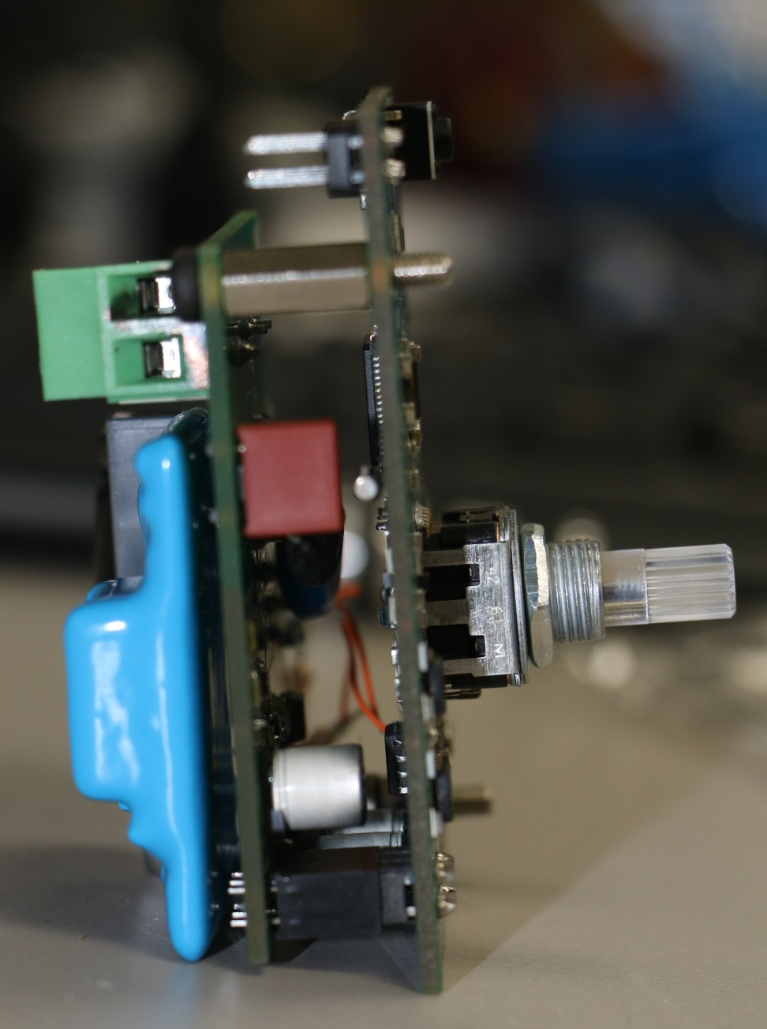
Hardware Features

Slide 9
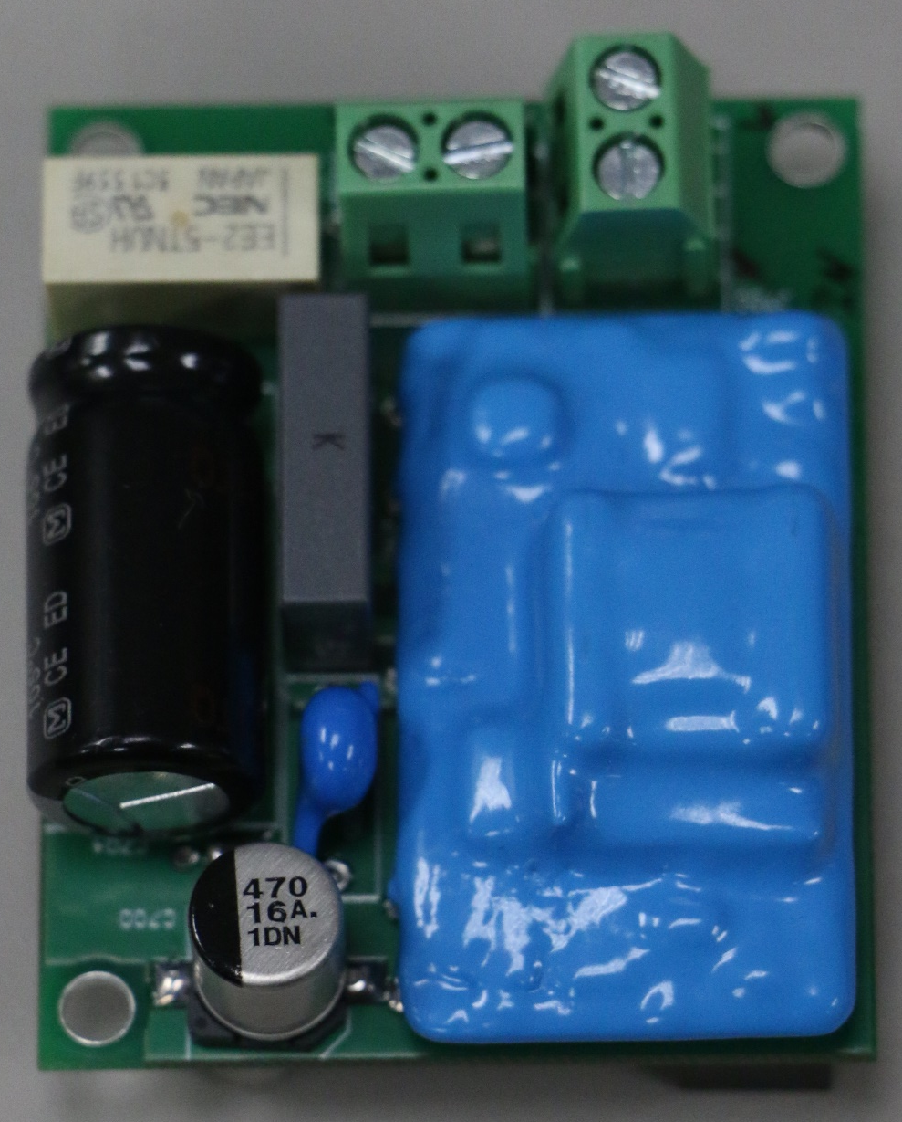
Hardware Features – Power Board
Input and Output Power Terminals
Relay
110VAC to 5V DC Power Supply
Compact Design
Notes:
Explain the purpose of each component briefly. Actual usage covered in software section.

Slide 10
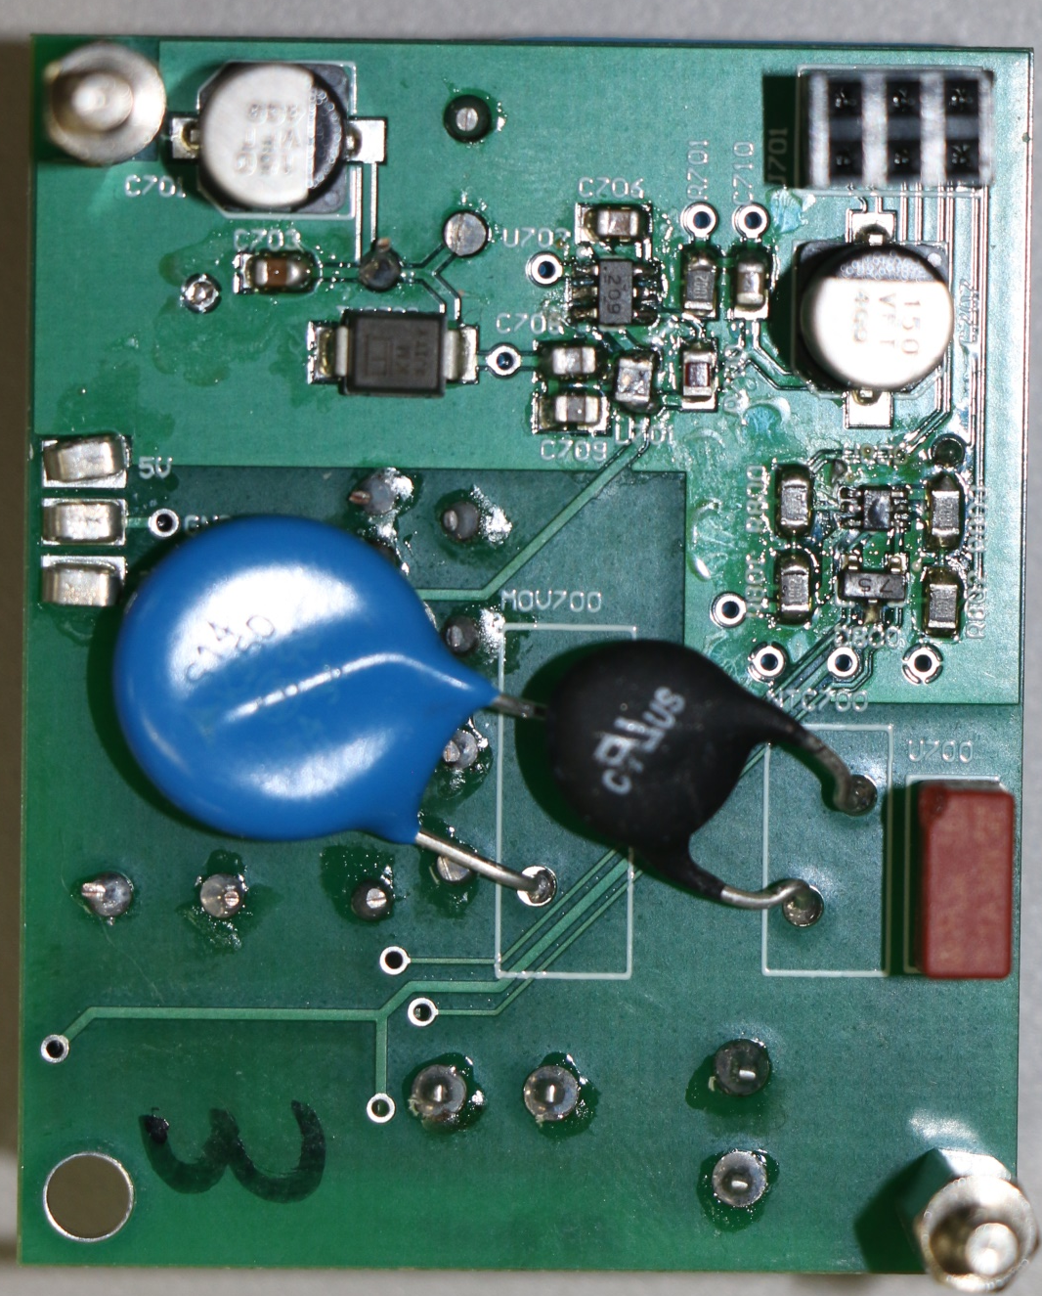
Back of Power Board
Inter-Board Header
5V, 3.3V, GND
Relay controls
5V DC to 3.3V DC regular
Relay Control FETs

Slide 11
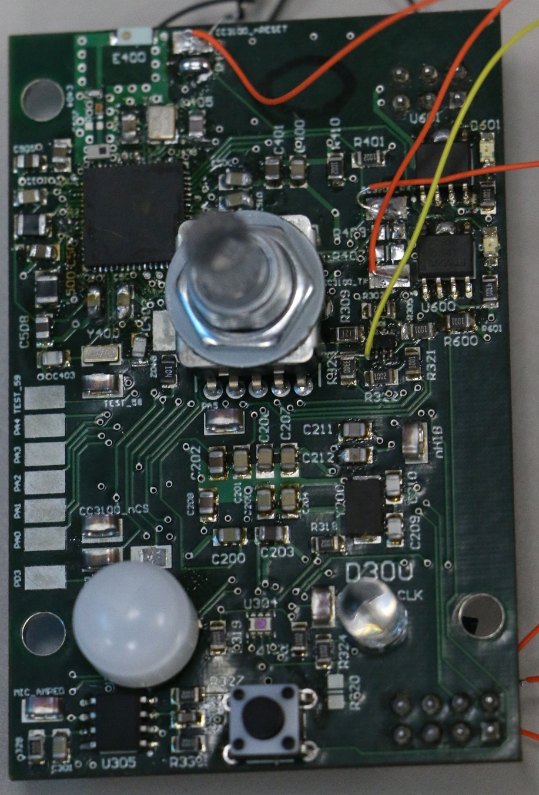
Hardware Features – Top Board
TI CC3100 Wi-Fi
Illuminated rotary encoder with push button
IR LED
Ambient Light Sensor
Motion Detector
Microphone
Notes:
Explain the purpose of each component briefly. Actual usage covered in software section.

Slide 12
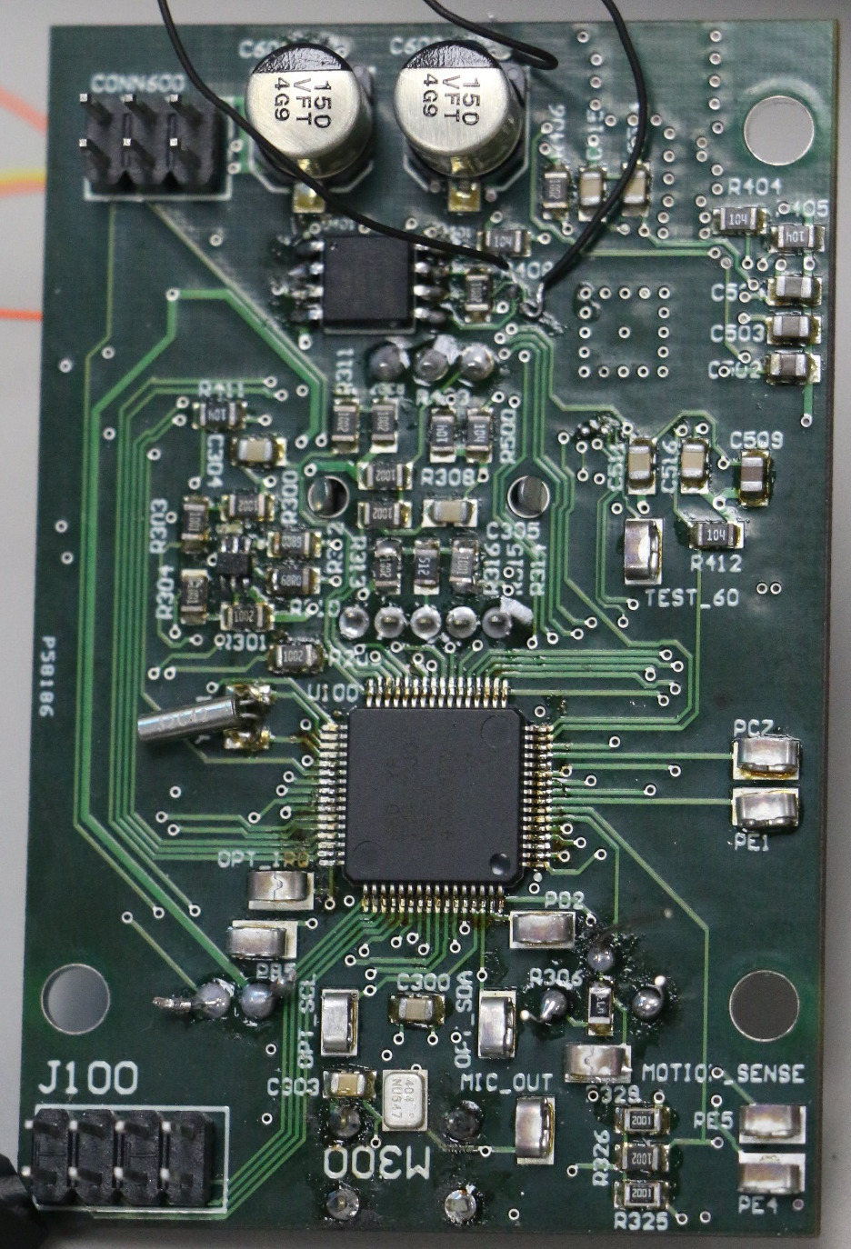
Hardware Features – Top Board (Back)
Tiva MCU
Microphone
Debug Header
UART
JTAG
Inter-Board Header

Slide 13
Contents
Why Lumos?
Hardware features
Capabilities
Power Board
Top Board
Software features
Tiva
Peripherals
Android App

Slide 14
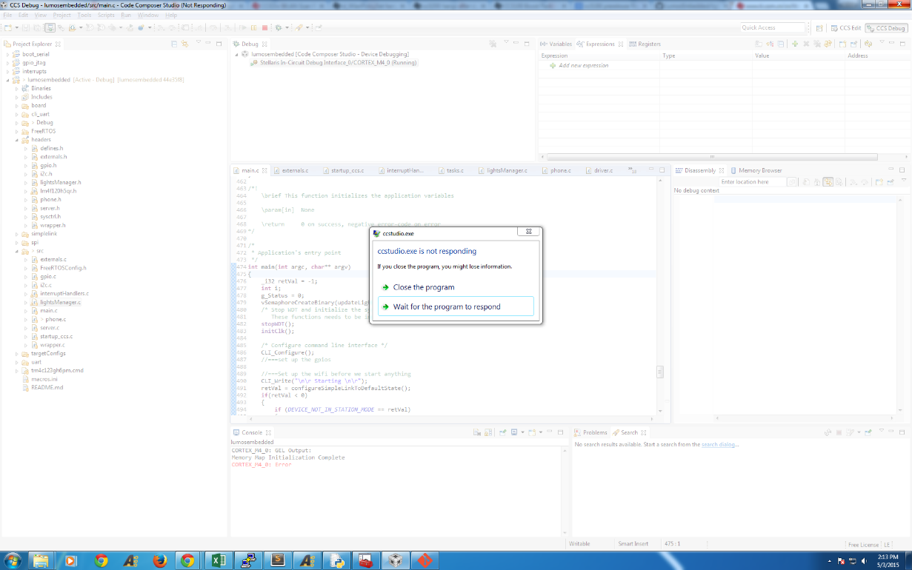
Software Features - Tiva
Multithreaded, non-blocking networking C code
Free RTOS
CC3100 SDK
Code Structure
Highly Modularized
Networking
Manual HTTP JSON PUT requests
Notes:
Explain how to use the board. What each component does. Describe software design? Demo while explaining?

Slide 15
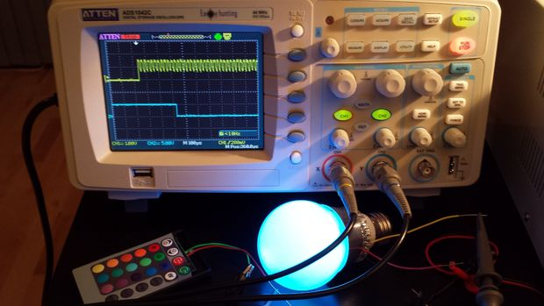
Software Features - IR
IR timer code
PWM and time adjustment
NEC format
http://www.instructables.com/id/Reverse-Engineering-RGB-LED-Bulb-with-IR-remote/

Slide 16
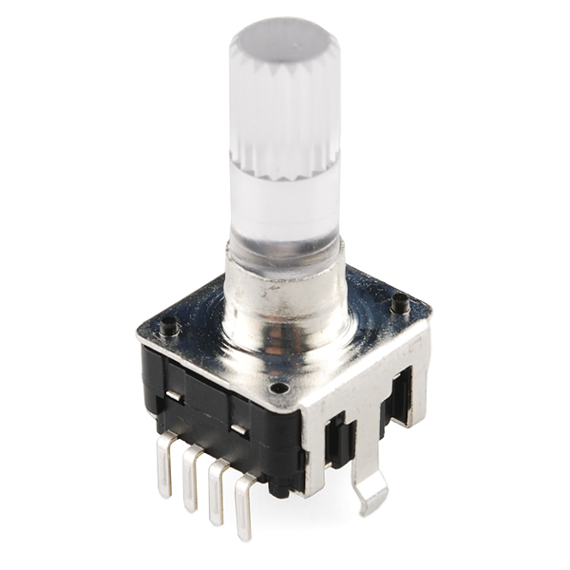
Software Features - Peripherals
Pushbutton Knob
Microphone
https://www.sparkfun.com/products/10596

Slide 17
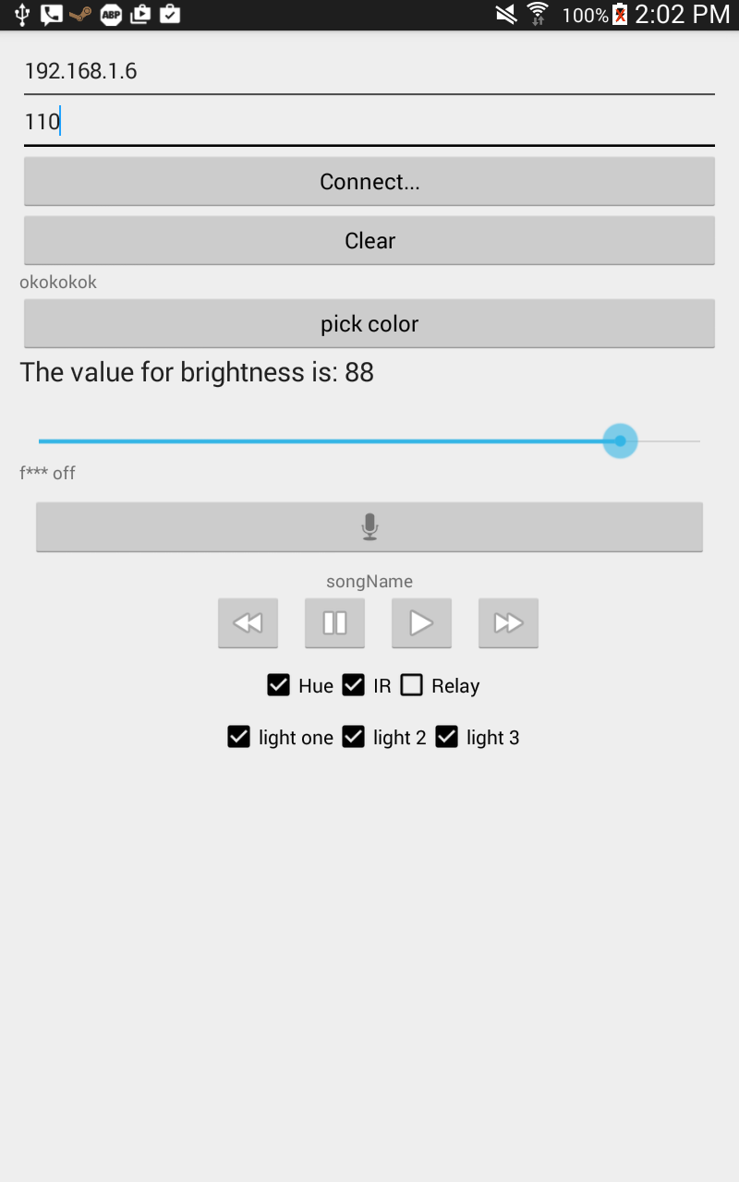
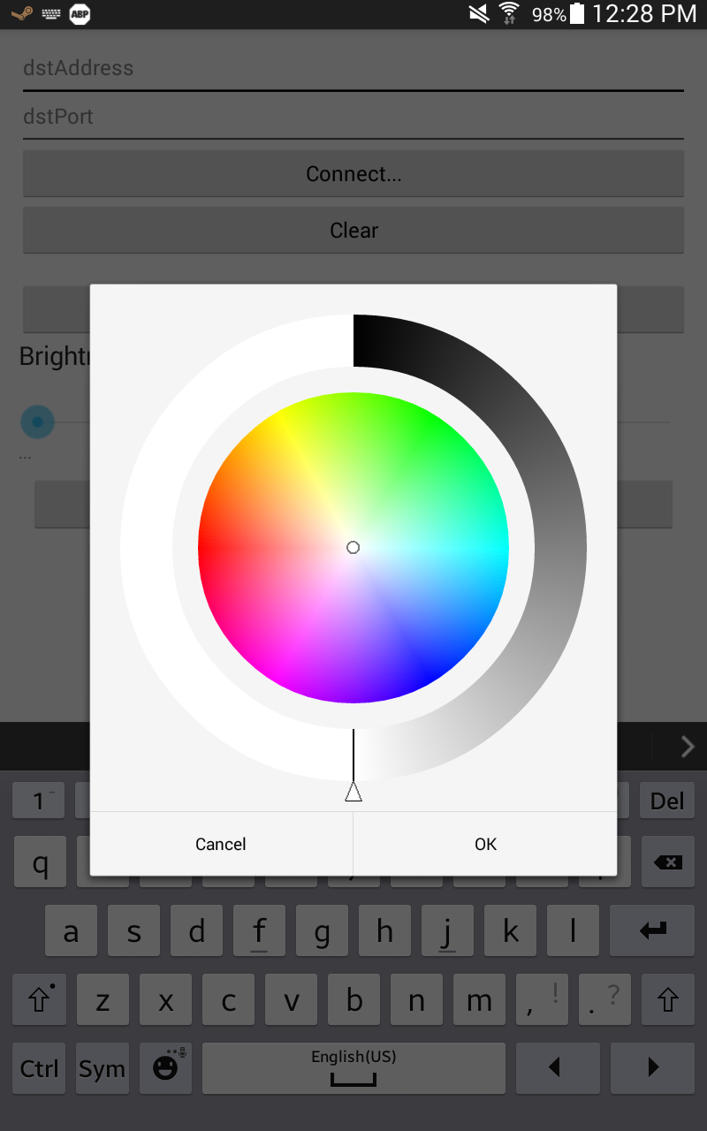
Software Features – Android App
Multithreaded sockets code
Android GUI
Android Async Task
Notes:
Explain main features of android app. Demo while explaining?

Slide 18
Questions?

